Slide 1
Agile Testing Practices
John Pourdanis
Test Automation Engineer

Slide 2
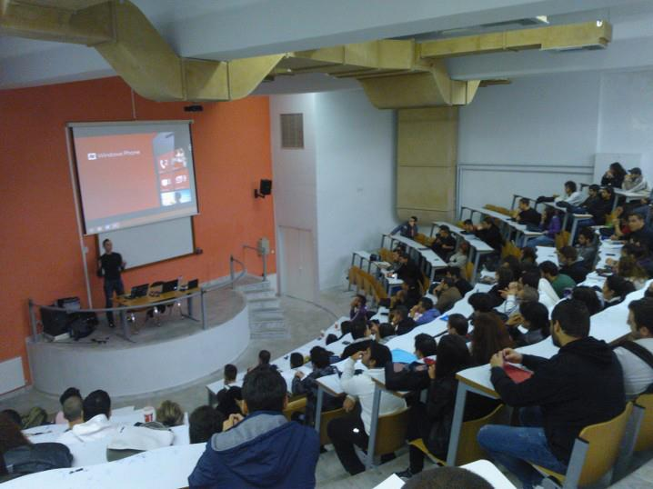
My first talk 8 years ago

Slide 3
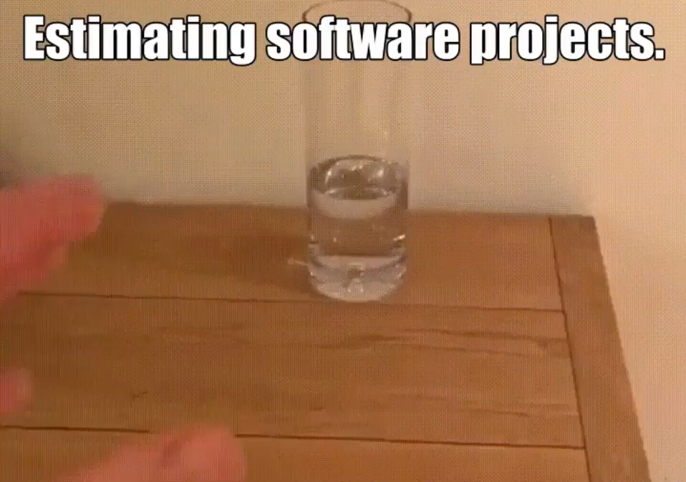

Slide 4
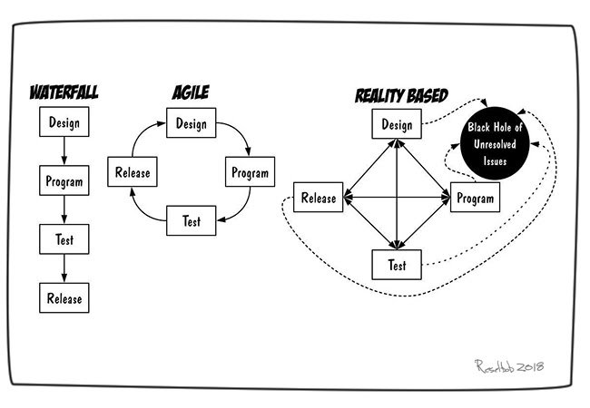

Slide 5
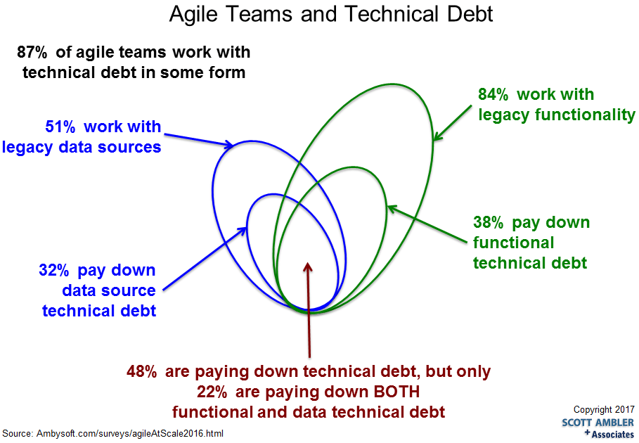

Slide 6
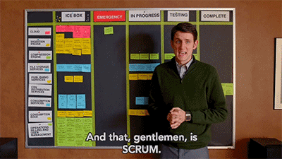
Agile – Scrum fits to your team

Slide 7

Agile Testing – 3 Amigos
Business (Product Owner) - What problem are we trying to solve?
Development (Developer) - How might we build a solution to solve that problem?
Testing (Tester) - What about this, what could possibly happen?

Slide 8
Agile Testing- Shift left testing
It is the first half of the maxim “Test early and often.”
Inject testing to the whole development life cycle.
45%-65% percent of defects are introduced in the requirements, architecture, and design activities
Work closely with Developers as a Team
Development Team != Testing Team

Slide 9
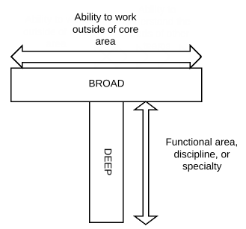
Agile Roles means agile skillset
Software development companies needs testers too.
Try to fit your personal skills to software industry.
Cross functional teams help avoiding people getting bored. T-shaped skilled persons.

Slide 10
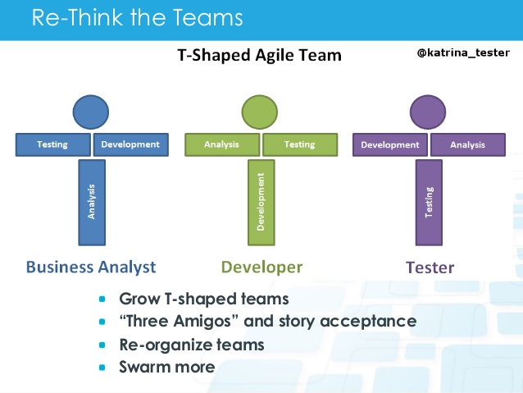

Slide 11
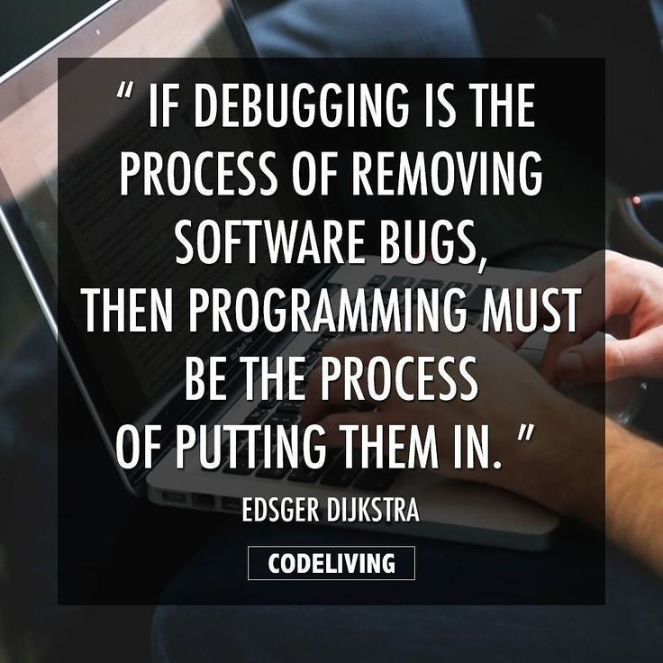

Slide 12
How much bugs cost?
In 2002, a study commissioned by the US Department of Commerce's National Institute of Standards and Technology concluded that "software bugs, or errors, are so prevalent and so detrimental that they cost the US economy an estimated $59 billion annually, or about 0.6 percent of the gross domestic product.
Starting with the big picture, software failures cost the worldwide economy $1.1 trillion in 2016. These failures were found at 363 companies, affected 4.4 billion customers, and caused more than 315 years of lost time.
Found at design phase by a walkthrough - $4
Found during coding by a walkthrough - $10
Found by unit test - $24
Found by integration test - $1600
Found by a customer after product shipped - $6,000

Slide 13
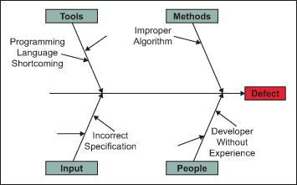

Slide 14


Slide 15
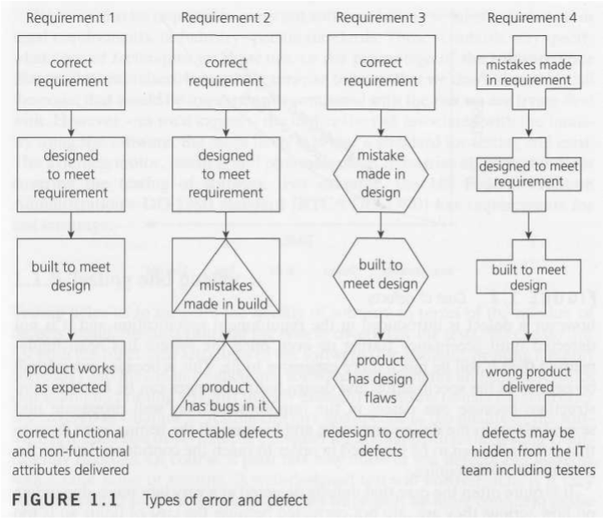

Slide 16
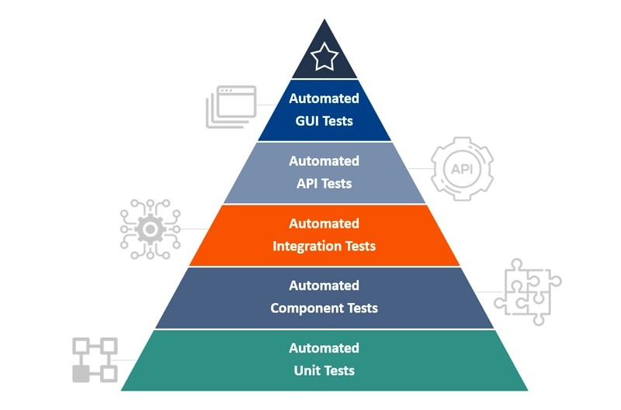

Slide 17
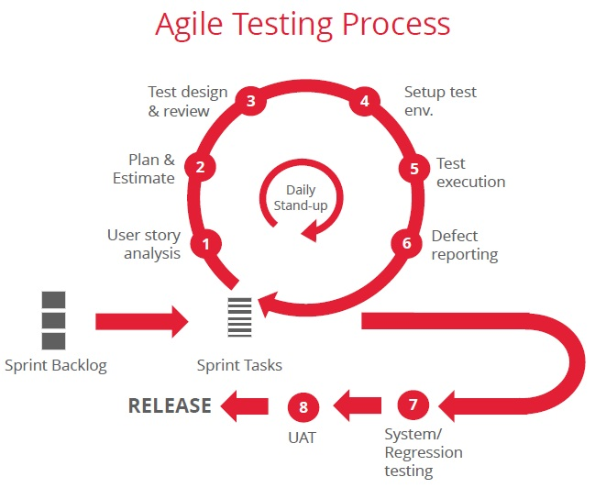

Slide 18
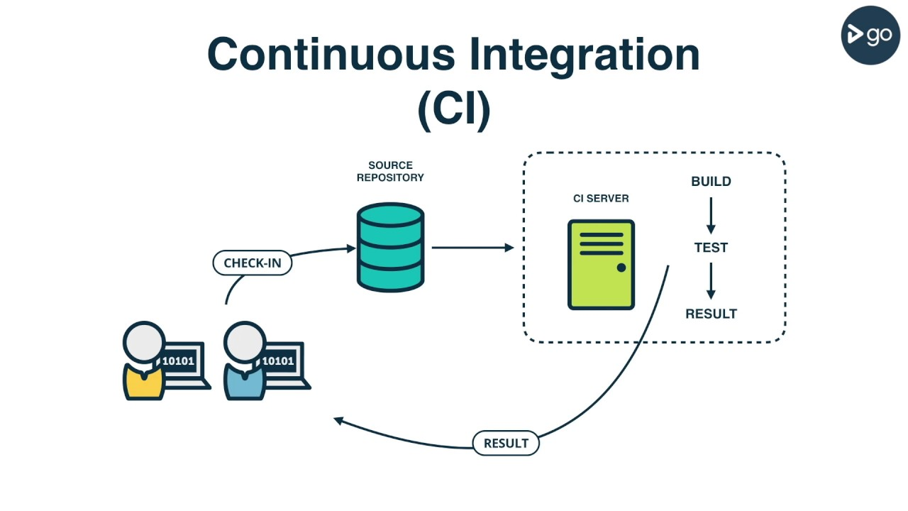

Slide 19
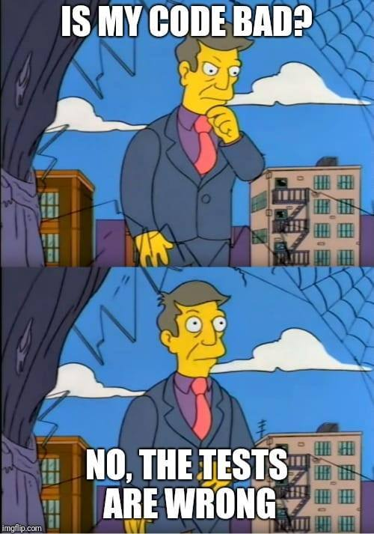

Slide 20
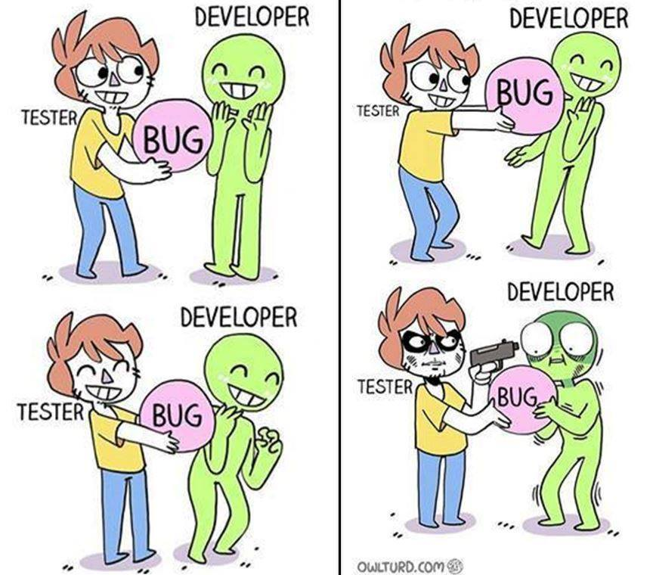

Slide 21
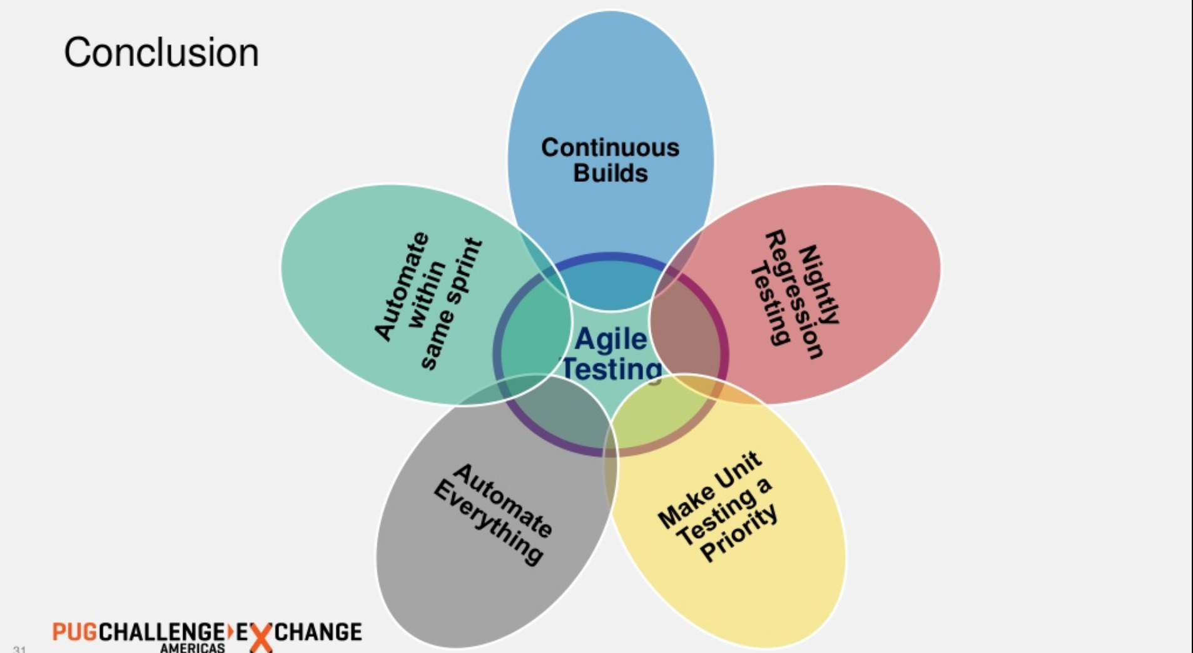

Slide 22


Slide 23
